Slide 1
Comprehensive Guide to Arrays and Strings in Data Structures
Dr. Machbah Uddin
Associate Professor
Dept. of Computer Science & Math
Bangladesh Agricultural University

Slide 2
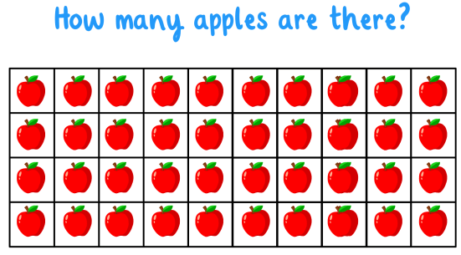
Arrays

Slide 3
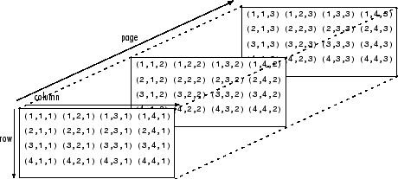
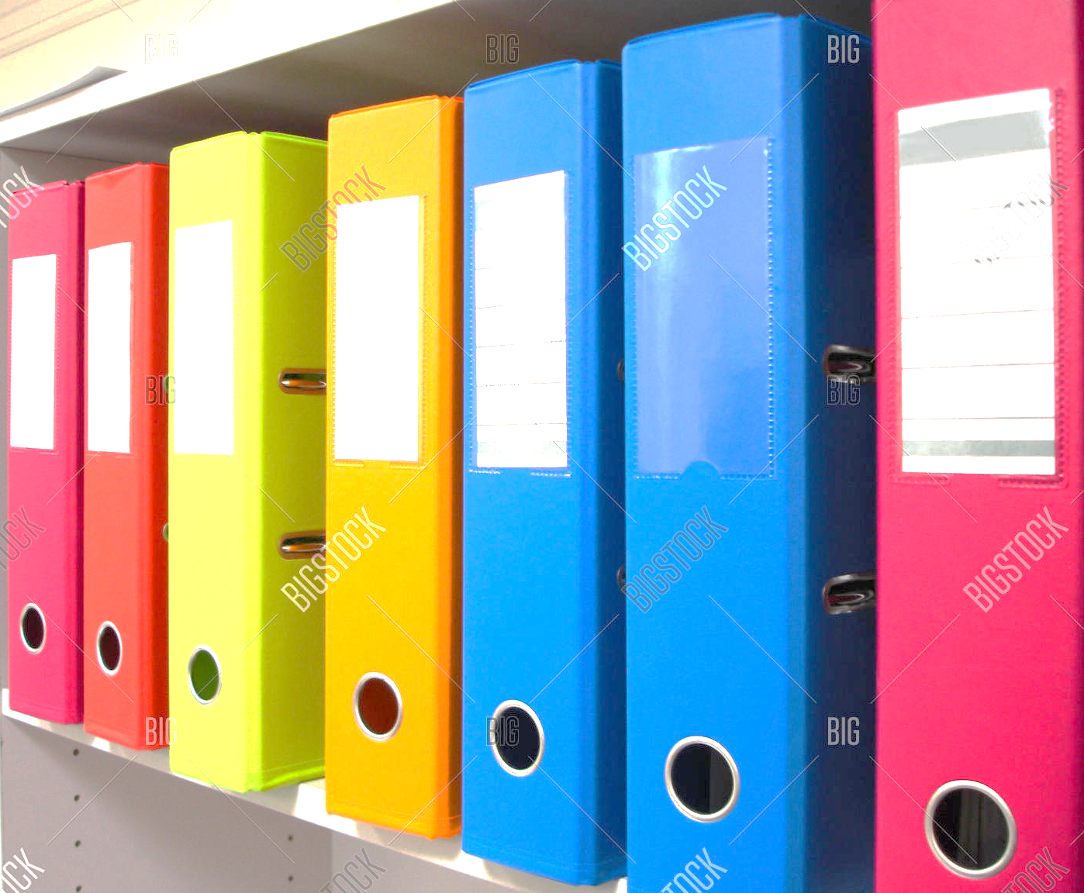
Array

Slide 4
What is an Array?
An array is a data structure that stores elements of the same type in contiguous memory.
It allows random access to elements using an index.
Types: One-dimensional (1D) and Multidimensional Arrays.

Slide 5
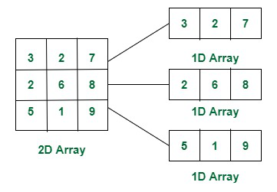
1D and 2D array

Slide 6
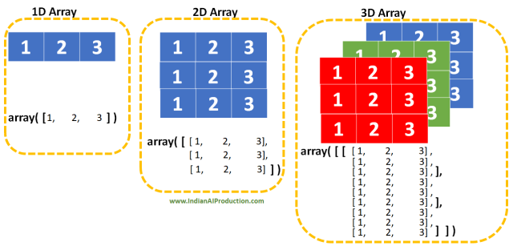
3D arrays

Slide 7
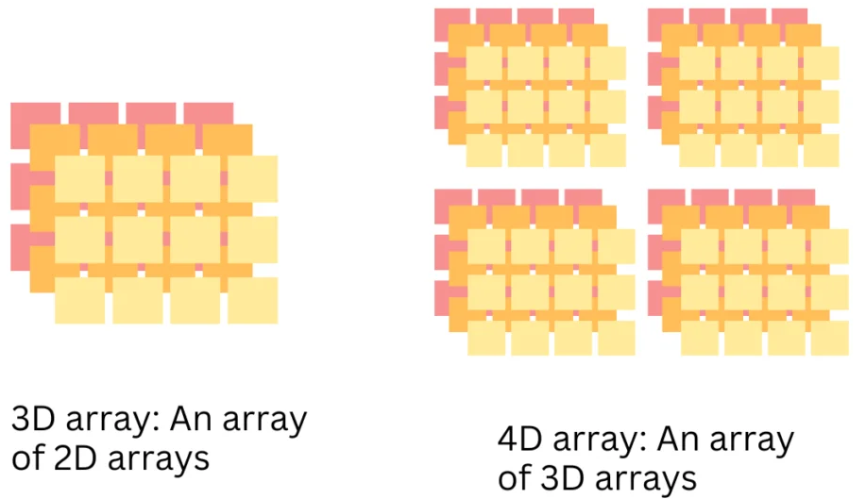
4D arrays

Slide 8
Why Use Arrays?
Efficient way to store multiple values.
Fast access time using indices.
Saves memory by avoiding overhead of pointers.

Slide 9
One-Dimensional Array (1D)
A linear data structure where elements are stored in a single row.
Example: int arr[5] = {1, 2, 3, 4, 5};

Slide 10
Multidimensional Arrays
Arrays with more than one index (e.g., 2D, 3D).
Example (2D Array): int matrix[3][3] = {{1,2,3},{4,5,6},{7,8,9}};

Slide 11
Array Operations Overview
Insertion
Traversal
Deletion
Searching

Slide 12
Insertion in Arrays
Adding an element at a specific position.
If inserting in the middle, shift elements to the right.

Slide 13
Example: Insertion
Given array: [10, 20, 30, 40]
Insert 25 at index 2:
[10, 20, 25, 30, 40]

Slide 14
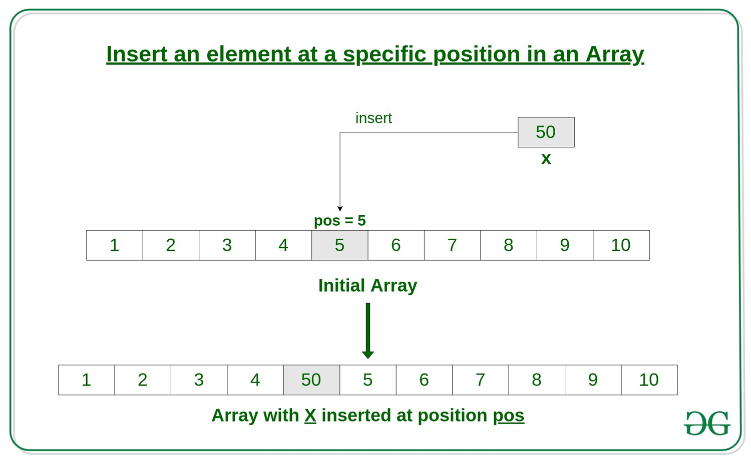
Array insert

Slide 15
Traversing an Array
Accessing each element one by one.
Can be done using loops.
Example: for i in range(len(arr)): print(arr[i])

Slide 16
Example: Traversal
Array: [5, 10, 15, 20]
Output: 5 10 15 20

Slide 17
Deletion in Arrays
• Removing an element by shifting elements to the left.
• Last element becomes empty.

Slide 18
Example: Deletion
Given array: [10, 20, 30, 40]
Delete element at index 2:
[10, 20, 40]

Slide 19
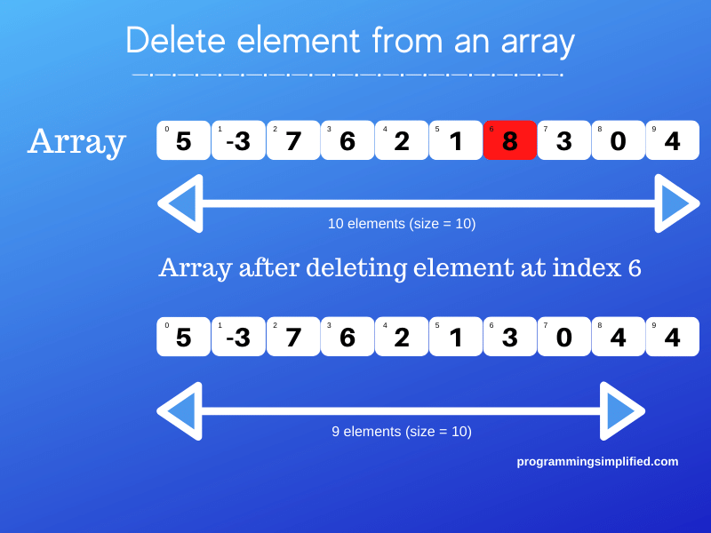
Array Element Delete

Slide 20
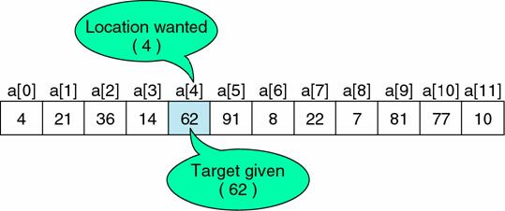
Search Operation in Arrays
• Linear Search: Check elements one by one.
• Binary Search: Works on sorted arrays, divides array into halves.

Slide 21
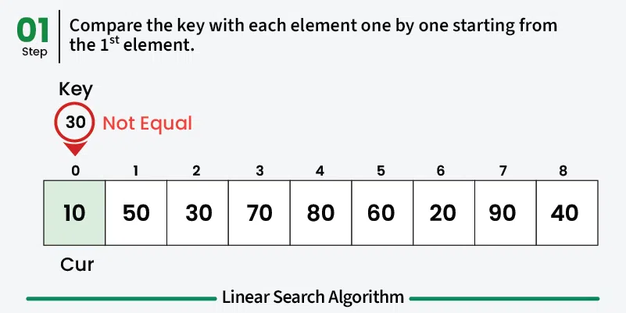
Example: Linear Search
Array: [5, 10, 15, 20]
Find 15 → Found at index 2.

Slide 22
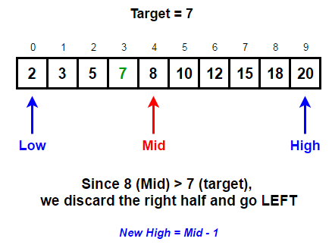
Example: Binary Search
Sorted Array: [5, 10, 15, 20]
Find 15 → Mid = 10 → Search right → Found.

Slide 23
2D Arrays: Traversal
• Uses nested loops.
Example:
for i in range(rows):
for j in range(cols):
print(matrix[i][j])

Slide 24
2D Arrays: Insertion
• Specify row and column index.
Example:
matrix[1][2] = 9

Slide 25
2D Arrays: Deletion
• Remove an element by shifting elements in a row/column.
Example:
Delete row 2 → Shift remaining rows up.

Slide 26
2D Arrays: Searching
• Linear search checks each element.
• Binary search only works on sorted 2D arrays.

Slide 27
Example: 2D Array Search
Given matrix:
[[1, 2], [3, 4]]
Find 3 → Found at (1,0).

Slide 28
Memory Representation of 1D Arrays
• Elements stored in contiguous memory.
• Address calculated as: Base Address + (Index * Size).

Slide 29
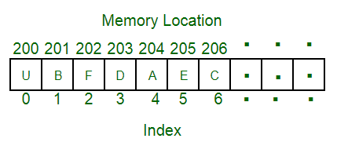
Example: Memory in 1D Arrays
Array: [10, 20, 30]
Base Address = 1000, Size = 4 bytes.
Addresses: 1000, 1004, 1008.

Slide 30
Memory Representation of 2D Arrays
• Stored in Row-Major or Column-Major Order.
• Address = Base + [(Row * ColCount) + Col] * ElementSize.

Slide 31
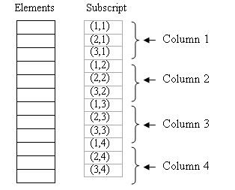

Slide 32
Example: Memory in 2D Arrays
Matrix: [[1, 2], [3, 4]]
Base Address = 1000, Size = 4 bytes.
Row-Major: 1000, 1004, 1008, 1012.

Slide 33
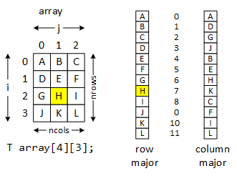
Comparing Row-Major vs Column-Major
Row-Major: Elements of each row stored together.
Column-Major: Elements of each column stored together.

Slide 34
Applications of Arrays
• Used in databases, image processing, and matrices.
• Data storage in programming languages.

Slide 35
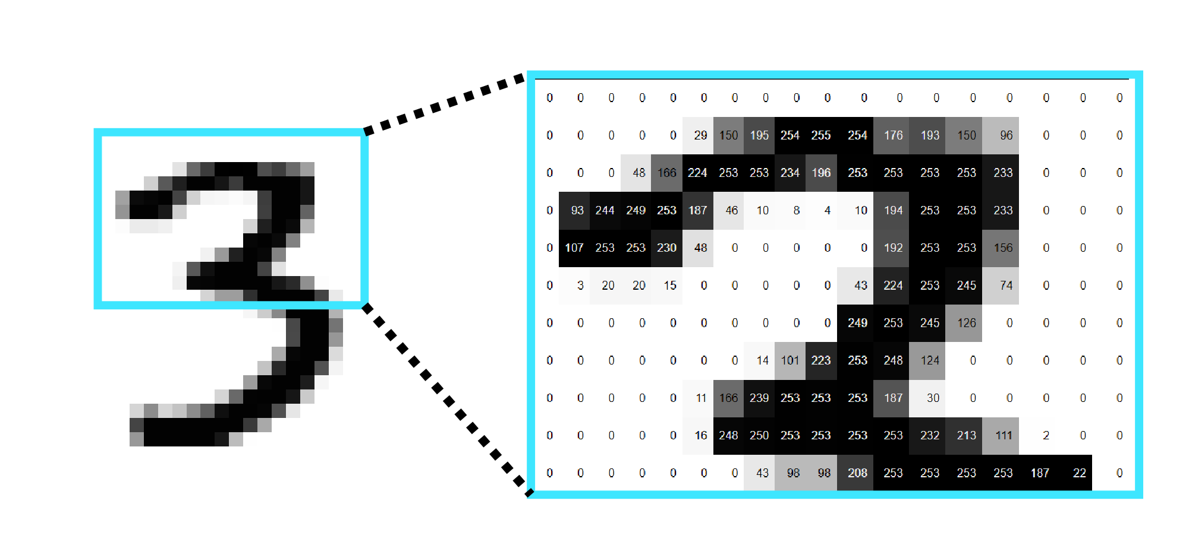
Real-World Example: Image Processing
Images stored as 2D arrays.
Pixel values accessed using array indices.

Slide 36
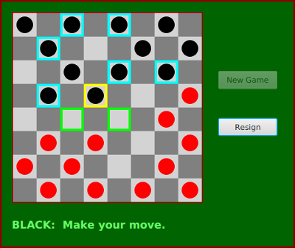
Real-World Example: Game Development
Grid-based games use 2D arrays.
Example: Chess board representation.

Slide 37
Challenges with Arrays
Fixed size (static arrays).
Costly insertions/deletions in the middle.

Slide 38
Conclusion
Arrays provide fast access to elements.
Different operations allow manipulation.
Used extensively in programming and applications.

Slide 39
Weather Monitoring
Problem: A meteorological department collects hourly temperature readings over a month. Design a system to store and analyze this data (e.g., find the highest, lowest, and average temperatures).
✅ Why Use an Array?
The number of readings per day is fixed (24 readings per day × 30 days = 720 readings).
Arrays allow fast indexing to access any hour’s data efficiently.

Slide 40
Implementation
temperatures = [30, 32, 28, 27, 31, 33, 29] # Example temperatures
highest = max(temperatures)
lowest = min(temperatures)
average = sum(temperatures) / len(temperatures)
print(f"Highest: {highest}, Lowest: {lowest}, Average: {average:.2f}")

Slide 41
Stock Price Prediction
Problem: A stock analyst wants to calculate a 5-day moving average of stock prices to identify trends.
✅ Why Use an Array?
The order of stock prices is crucial (sequential data).
Arrays provide efficient traversal for calculating moving averages.

Slide 42
Implementation
stock_prices = [100, 102, 101, 99, 98, 97, 103]
window_size = 5
moving_averages = [sum(stock_prices[i:i+window_size])/window_size for i in range(len(stock_prices)-window_size+1)]
print(moving_averages)

Slide 43
Traffic Management System (Car Plate Number Logs)
Problem: A smart traffic system stores license plate numbers of 10,000 cars daily to analyze rush hours and detect duplicate entries.
✅ Why Use an Array?
The data is large but structured (each car plate is stored at a fixed index).
Arrays allow quick searching and pattern analysis.

Slide 44
Implementation
car_plates = ["ABC123", "XYZ789", "LMN456", "XYZ789"] # Duplicate detected
duplicates = set([plate for plate in car_plates if car_plates.count(plate) > 1])
print(f"Duplicate Plates: {duplicates}")

Slide 45
DNA Sequence Matching
Problem: Bioinformatics researchers store long DNA sequences as character arrays and need to find whether a smaller DNA sequence exists in a larger one.
✅ Why Use an Array?
DNA sequences are naturally stored as arrays of characters.
Efficient searching algorithms (like KMP or Rabin-Karp) require array-based processing.

Slide 46
Implementation
def is_subsequence(dna, sub):
return sub in dna
dna_sequence = "AGCTTAGGCTA"
sub_sequence = "GGCT"
print("Found!" if is_subsequence(dna_sequence, sub_sequence) else "Not Found!")

Slide 47
Strings
Definition: A string is a sequence of characters.
Examples: "Hello, World!", "DNA Sequence: ATGC", "Binary String: 101010".
Importance in computer science: Text processing, data storage, and communication.
Applications: Search engines, bioinformatics, cryptography, and more.

Slide 48
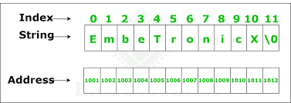
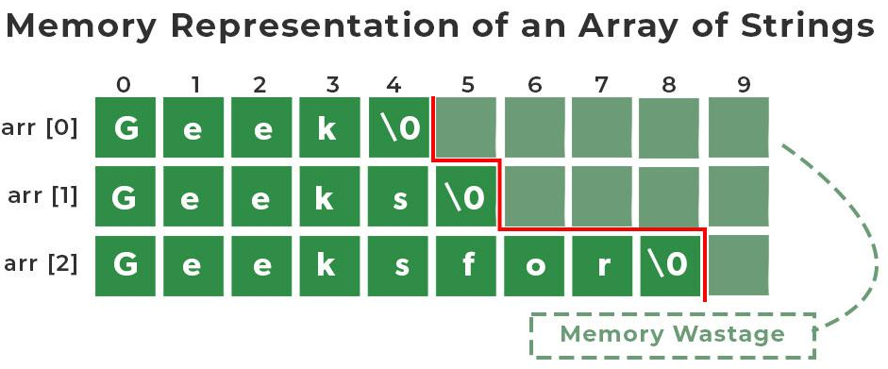

Slide 49
String Operations
Basic Operations:
Concatenation: "Hello" + "World" = "HelloWorld".
Substring extraction: "HelloWorld".substring(0, 5) = "Hello".
Length calculation: len("Hello") = 5.
Advanced Operations:
Searching for patterns.
Replacing substrings.
Splitting and joining strings.

Slide 50
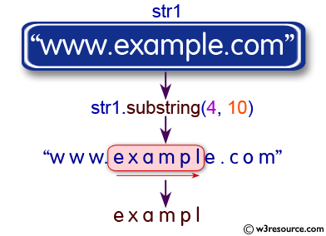
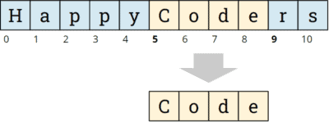
Substring

Slide 51
String searching
Naive (Brute-Force) Search:
Checks every possible substring.
Time complexity: O(n*m), where n = text length, m = pattern length.
Knuth-Morris-Pratt (KMP) Algorithm:
Uses a prefix table to skip unnecessary comparisons.
Time complexity: O(n + m).
Boyer-Moore Algorithm:
Skips characters based on bad character and good suffix rules.
Time complexity: O(n/m) in best case.
Rabin-Karp Algorithm:
Uses hashing to compare patterns.
Time complexity: O(n + m) on average.

Slide 52
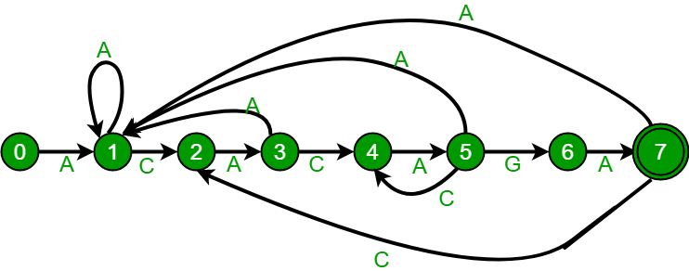
Pattern Search

Slide 53
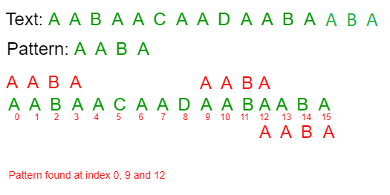
Pattern Search

Slide 54
DNA Sequence Matching
Problem: Given a DNA sequence and a short query sequence, find all occurrences of the query in the DNA sequence.
Why mandatory? DNA sequences are represented as strings (A, T, G, C). Using arrays wouldn't work efficiently for pattern matching.

Slide 55
DNA Sequence Matching
def find_dna_sequence(dna, query):
positions = []
for i in range(len(dna) - len(query) + 1):
if dna[i:i+len(query)] == query:
positions.append(i)
return positions
dna_sequence = "ATGCGATGACCTGAGGCTAGCATGAC"
query_sequence = "ATG"
print(find_dna_sequence(dna_sequence, query_sequence)) # Output: [0, 6, 20]

Slide 56
Password Strength Checker
Problem: Verify if a password meets security standards (length, uppercase, special character, etc.).
🔹 Why mandatory? Passwords are always stored and validated as strings.

Slide 57
Password Strength Checker
import re
def check_password_strength(password):
if (len(password) >= 8 and
re.search(r'[A-Z]', password) and
re.search(r'[a-z]', password) and
re.search(r'[0-9]', password) and
re.search(r'[@#$%^&+=]', password)):
return "Strong Password"
return "Weak Password"
print(check_password_strength("Pass@123")) # Output: Strong Password
print(check_password_strength("pass123")) # Output: Weak Password

